Slide 1
Reminder: Assignment 1st Deadline
13 Oct 2016:
Submit your use case diagram on Blackboard
This week’s practical is to reinforce the usecase lecture in week 2 and help with assignment.
Get into groups to identify actors and usecases for the case study below. For each use case, write the use case description.
Get into groups to explore some usecases identified above.
Individual exercises, draw your usecase diagrams using ArgoUML.

Slide 2
UFCFB6-30-2 Object-oriented Software Development
Unit 3 Class diagram
Jin Sa
2016-17

Slide 3
Outline
Classes and objects : summary
Class diagrams in UML
Encapsulation
Visibility
UML class state: attributes
Multiplicity
UML class behaviour: operations and parameters
Class relationships

Slide 4
Classes and objects : summary (skip)
A class is a blueprint for an object. The class defines the generic behaviour of an object and the type of data it may store
Objects that behave in a manner specified by a class are called instances of that class.
Example
A Film class :
data could include title of the film and the certification rank
Methods could be modifying certification rank
One instance of the Film class could contain details of the film “Lincoln” and another “Life of Pi”.
Each of the instances stores exactly the same type of data, film name, certification and classification yet each one represents a different film.

Slide 5
Classes and objects : summary (skip)
Classes define the behaviour and the data types for an object
Values of the data held in instances of the same class will typically vary.
Instances of the same class provide exactly the same services (subject to the data not controlling the flow).

Slide 6
UWEFlix Case study
Case Study UweFlix.doc

Slide 7
Film class and objects
Class
Attributes:
string title
string ageRating
Methods:
getTitle
getAgeRating
toString
Objects
Film f1 has
title=“Life of Pi”
ageRating=“PG”
Film f2 has
title=“The Martian”
ageRating=“12a”
Film f3 has
title=“House of flying dagger…”
ageRating=“15”

Slide 8
class Film {
private String title;
private String ageR;
public Film(String t, String r){
title=t;
ageR=r;
}
……
public String toString(){
return “title is:” + title +
“age rating is:”+ ageR;}
//more methods
}
… … main(String [] args){
Film f1 = new Film (“Life of Pi”, “PG”);
Film f2 = new Film (“The Martian”, “12a”);
}
Notes:
Show the film sheets

Slide 9
Screen class and objects (skip)
Class
Attributes:
int id
int capacity
Methods:
getID
getCap
toString
Update Capacity
Objects
Screen s1 has
id=1
capacity=50
Screen s2 has
id=2
capacity=100

Slide 10
class Screen {
private int id;
private int cap;
public Screen(int I, int c){
id=I;
cap=c;
}
public int getId(){
return id;}
public int getCap(){
return cap;
}
……
}

Slide 11
Main program
… … main(String [] args){
Film f1 = new Film (“Life of Pi”, “PG”);
Film f2 = new Film (“The Martian”, “12a”);
Screen s1 = new Screen (1, 50);
Screen s2 = new Screen (2, 100);
}
Notes:
Show the screen sheets

Slide 12
Showing class and objects
What information (attributes) do we want to have?

Slide 13
Showing class and objects
What information (attributes) do we want to have?
Information about the film being shown
Date and time of showing
Which screen
How many seats left for this showing

Slide 14
Showing class and objects
What behaviour (methods) do we need to have?
toString (include information about date and time, what film, which screen ID)
getSeatsLeft (returns information about how many tickets are available)
UpdateSeatsLeft (every time a booking is made, the seatsLeft attribute is reduced)

Slide 15
Showing version 1
class Showing {
private String filmTitle;
?????
private String timedate;
private int screenId;
private int seatsLeft;
public Showing(……){
……
}
//more methods
}

Slide 16
Main program
… … main(String [] args){
Film f1 = new Film (“Life of Pi”, “PG”);
Film f2 = new Film (“The Martian”, “12a”);
Screen s1 = new Screen (1, 50);
Screen s2 = new Screen (2, 100);
Showing sh1 = new Showing(“Life of Pi”,
“10am 11 Aug 2011”, 1, 50);
Showing sh2 = new Showing(“Life of Pi”,
“7pm 11 Aug 2011”, 2, 100);
}
Not good …
Notes:
Show the showing sheets with the post it cover

Slide 17
Showing class and film
How do we store information about the film being shown?
In the Showing class? What’s the disadvantages?
Discuss
Use the information in Film
Discuss

Slide 18
Showing class and film
How do we store information about the film being shown?
In the Showing class? What’s the disadvantages?
Duplicate information about the film in all showing objects of this film
Difficult to maintain program when information is duplicated, need to change all.
Use the information in Film
Have a reference (link) to the film object
Send message to the film object to get information about the film when required

Slide 19
Showing 2
class Showing {
private Film film;
private String timedate;
private int screenId;
private int seatsLeft;
//more methods
}

Slide 20
Showing 2
public Showing(Film f, String t, int s,
int seats){
film=f;
timedate=t;
screenId=s;
seatsLeft=seats;
}
public String toString(){
String filmInfo= film.toString();
return filmInfo+timedate+ …
}
//more methods
}

Slide 21
Main program
public static void main(String [] args){
Film f1 = new Film (“Life of Pi”, “PG”);
Film f2 = new Film (“The Martian”, “12a”);
Screen s1 = new Screen (1, 50);
Screen s2 = new Screen (2, 100);
Showing sh1 = new Showing(f1,
“10am 11 Aug 2011”, 1, 50);
Showing sh2 = new Showing(f1,
“7pm 11 Aug 2011”, 2, 100);
}
Notes:
Show the showing sheets and introduce the links
Show the main program sheet

Slide 22
Part of the UweFlix system
Film
The link is implemented as an object reference in oop
Showing

Slide 23
Using the reference f1 – no duplication
No need to store information about “Life of Pi” in both showings and the film.
Easier to maintain if information about “Life of Pi” changes.

Slide 24
Main program – more about using object reference (skip)
public static void main(String [] args){
Film f1 = new Film (“Dark Knight”, “12a”);
Film f2 = new Film (“The Martian”, “12a”);
Screen s1 = new Screen (1, 50);
Screen s2 = new Screen (2, 100);
Showing sh1 = new Showing(f1,
“10am 11 Aug 2011”, 1, 50);
Showing sh2 = new Showing(f1,
“7pm 11 Aug 2011”, 2, s2.getCap());
}
Notes:
Show the showing sheets and introduce the links
Show the main program sheet

Slide 25
UML class
Every class must have a name, e.g. Showing
An attribute (data) is a named property of a class that describes a range of values that instances of the property may hold, e.g. every customer has a name and an address.
Do not include temporary variables
An operation is an implementation of a service that can be requested from any object of the class to affect behaviour, e.g. getSeatLeft()

Slide 26
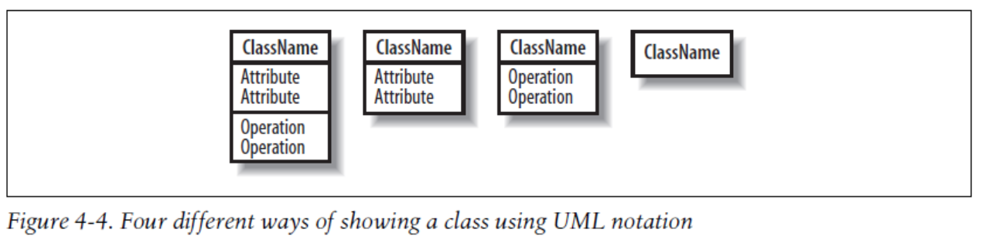
Class diagrams in UML
A class diagram describes the types of objects in the system and the various kinds of static relationships that exist among them.
Class diagrams also show the properties (attributes and associations) and operations of a class and the constraints that apply to the way objects are connected.

Slide 27
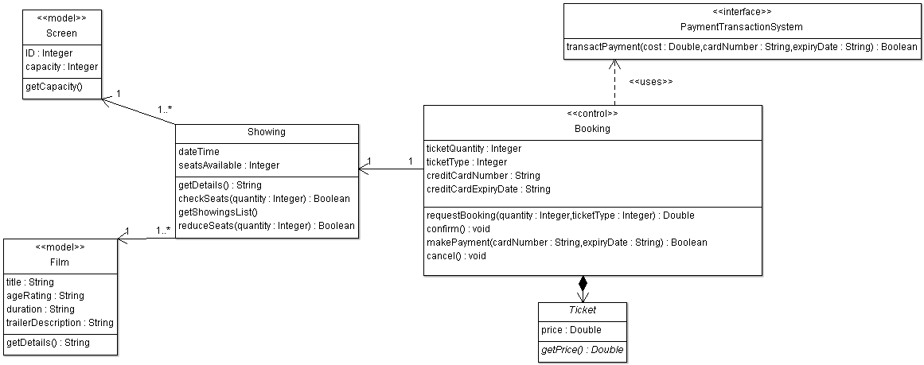
Examples of classes

Slide 28
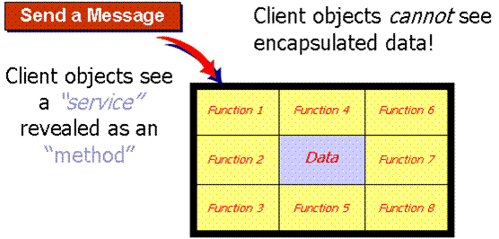
Encapsulation
An object contains both data—attributes—and the instructions that affect the data—operations.
Encapsulation refers to the process of an object controlling outside access to its internal data.
Client only knows how to call the methods, not how the methods are implemented.
Data attributes are made private, i.e. protected from being directly accessed from outside
Visible methods (services) are made public

Slide 29
Benefits of encapsulation
A class can change the way it works internally and as long as those internals are not visible to the rest of the system, those changes will have no effect on how the class is interacted with other parts of the system.
By keeping data private and providing public well-defined service methods the role of the object becomes clear to other objects. This increases usability.
Encapsulation of operations and data within an object is probably the single most powerful and useful part of the object-oriented approach to system design.

Slide 30
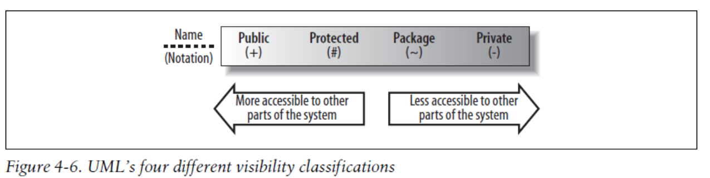
Visibility
There are four different types of visibility that can be applied to the elements of a UML model
Typically these visibility characteristics will be used to control access to both attributes, operations, and sometimes even classes

Slide 31
Visibility modifiers
Public Visibility
specified using the plus (+) symbol
Declare an attribute or operation public if you want it to be accessible directly by any other class.
It’s usually best to avoid public attributes except for constants
Protected Visibility
specified using the hash (#) symbol
can be accessed by methods that are part of your class and also by methods that are declared on any class that inherits from your class.
Java has a different implementation
Notes:
Many
object-oriented designers groan at the use of public attributes: opening a class’s
attributes to the rest of the system is like exposing your house to any person off the
street without requiring him to check with you before entering. There is just as much
potential for abuse.
Protected elements cannot be accessed by a class
that does not inherit from your class whether it’s in the same package or not, as
shown in Figure 4-8. See Chapter 5 for more information on inheritance relationships
between classes.
Protected visibility is crucial if you want to allow specialized classes to access an
attribute or operation in the base class without opening that attribute or operation to
the entire system. Using protected visibility is like saying, “This attribute or operation
is useful inside my class and classes extending my class, but no one else should
be using it.”
Java confuses the matter a little further by allowing access to protected
parts of a class to any other class in the same package. This is
like combining the accessibility of protected and package visibility,
which is covered in the next section.

Slide 32
Visibility modifiers
Package Visibility (also called default visibility)
specified with a tilde (~),
any class in the same package can directly access attributes or operations declared with package visibility modifier
Private Visibility
most tightly constrained, and is shown by a minus (-) symbol
Only the class that contains the private element can see or work with the data stored in a private attribute or make a call to a private operation,
Private visibility is most useful if you have an attribute or operation that you want no other part of the system to depend on. If you intend to change an attribute or operation at a later time but don’t want other classes with access to that element to be changed.
It’s a commonly accepted rule of thumb that attributes should always be private
Notes:
For example, if you were designing a package of utility classes and wanted to reuse
behavior between those classes, but not expose the rest of the system to that behavior,
then you would declare package visibility to those particular operations internally
to the package. Any functionality of utility classes that you wanted to expose to
the rest of the application could then be declared with public visibility.

Slide 33
Public visibility example

Slide 34
Protected visibility example

Slide 35
Package (default) visibility example

Slide 36
Private visibility modifier

Slide 37
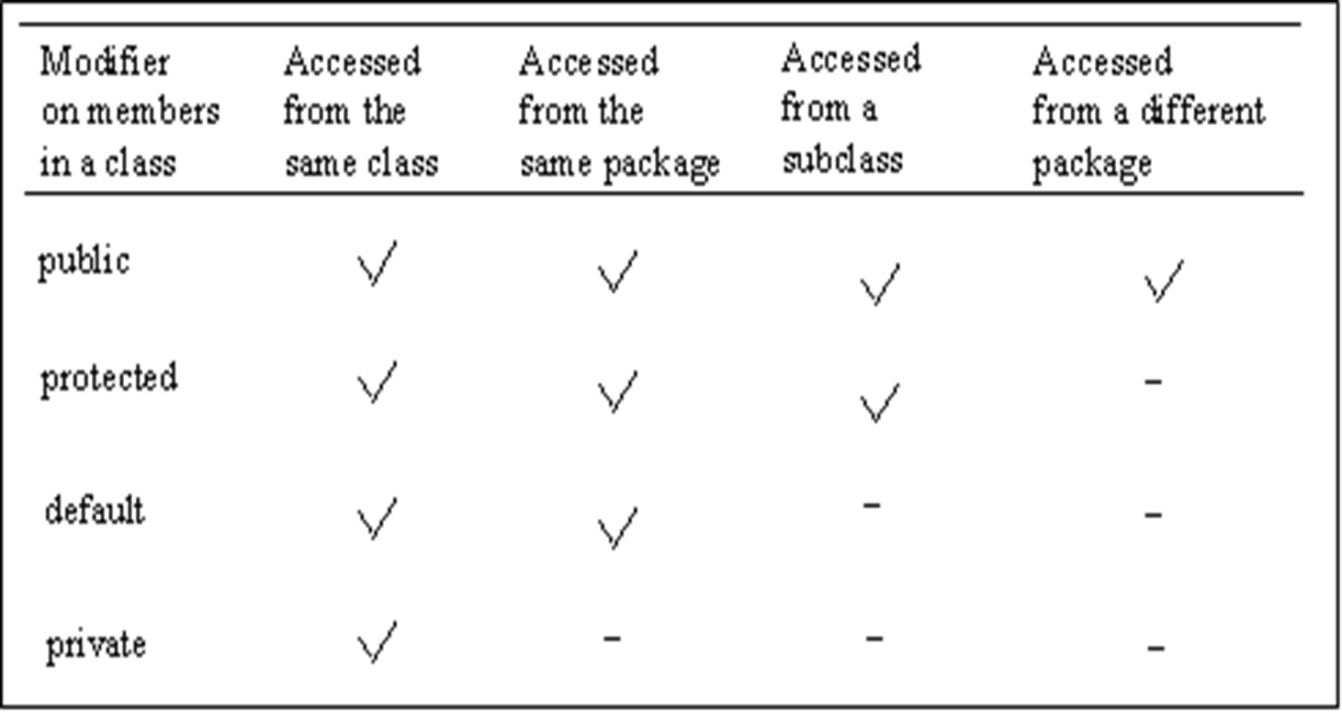
Visibility summary (Java) (skip)

Slide 38
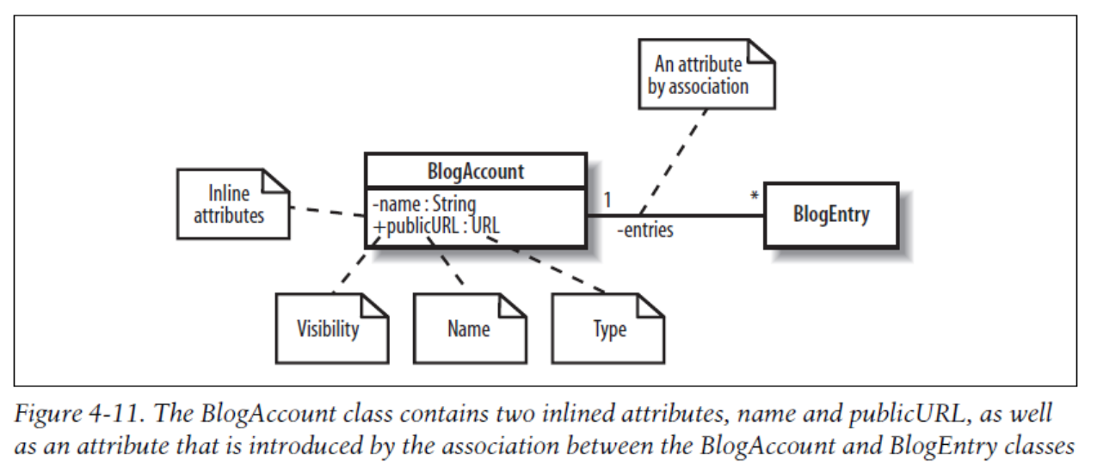
UML class state: attributes
Attributes can be represented on a class diagram either as inline attributes or by association with another class

Slide 39
Java inline and by-association attributes
public class BlogAccount
{
// The two inline attributes
private String name;
public URL publicURL;
// The single attribute by association,
// given the name 'entries'
private BlogEntry[] entries;
// ...
}

Slide 40
Inline Attributes Versus Attributes by Association
One useful rule of thumb: “simple” classes, such as the String class in Java, or standard library classes are generally best shown as inline attributes.

Slide 41
Multiplicity
An attribute could represent any number of objects of its type
Multiplicity allows you to specify that an attribute represents a collection of objects
it can be applied to both inline and attributes by association,
A * at the BlogEntry class end of the association indicates that any number of BlogEntry objects will be stored in the entries attribute within the BlogAccount class.
The 1 specified at the other end of the association indicates that each BlogEntry object in the entries attribute is associated with one and only one BlogAccount object.
Notes:
this is like declaring that an attribute is an array.
The entries attribute that is introduced using an association between the
BlogAccount class and the BlogEntry class has two multiplicity properties specified at
either end of the association. A * at the BlogEntry class end of the association indicates
that any number of BlogEntry objects will be stored in the entries attribute
within the BlogAccount class. The 1 specified at the other end of the association indicates
that each BlogEntry object in the entries attribute is associated with one and
only one BlogAccount object.
Those with a keen eye will have also noticed that the trackbacks, comments, and
entries attributes also have extra properties to describe in even more detail what the
multiplicity on the attributes means. The trackbacks attribute represents any number
of objects of the Trackback class, but it also has the unique multiplicity property
applied to it. The unique property dictates that no two Trackback objects within the
array should be the same. This is a reasonable constraint since we don’t want an
entry in another blog cross-referencing one of our entries more than once; otherwise
the list of trackbacks will get messy.

Slide 42
Multiplicity of instances
1
class
exactly one
*
class
zero or more
0..1
class
optional
(zero or one)
1..*
class
one or more
1..2, 4..6
class
numerically
specified
Notes:
Multiplicity should be indicated at each end of an association.
This specifies the minimum and maximum number of instances that can be linked. (E.g. a Car has 3 or 4 Wheels, but each Wheel belongs to exactly one Car).
The minimum and maximum values are separated by two dots.
An asterisk (*) represents an indeterminate maximum.
Where the minimum and maximum are the same, the number need only be shown once.
Also zero-or-more (0..*) is shortened to a simple asterisk (*) because it is so common.
Finally, ranges and/or single values can be comma-separated to enumerate alternative values.

Slide 43
Examples of classes with multiplicities

Slide 44
UML class behaviour: operations and parameters

Slide 45
Static parts of your class
Notes:
If the accountCounter attribute were not static, then every BlogAccount instance
would get its own copy of the accountCounter attribute. This would not be very useful
at all since each BlogAccount object would update only its own copy of accountCounter
rather than contributing to a master object instance counter—in fact, if accountCounter
were not static, then every object would simply increment its own copy to 1 and then
decrement it to 0 when it is destroyed, which is not very useful at all!

Slide 46
Class relationships

Slide 47
Dependency
A dependency between two classes declares that a class needs to know about another class to use objects of that class.
often used when you have a class that is providing a set of general-purpose utility functions, such as in Java’s mathematics (java.math) packages. Classes depend on the java.math classes to use the utilities that those classes offer.
Notes:
Show example of parameter, and external payment

Slide 48
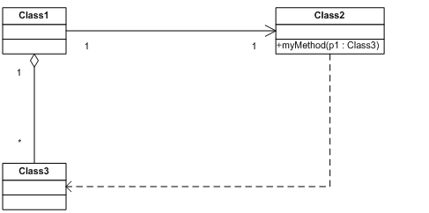
Example of dependency
Accessing service to an external system
A dependency will occur when passing an object type as a method argument.
In this situation a class (class 1) sends a message to another class (class 2) passing a parameter of third type of class (class 3). This is illustrated in the diagram below.

Slide 49
Association without navigability applied to their association relationship
Association means that a class will actually contain a reference to an object, or objects, of the other class in the form of an attribute

Slide 50
The BlogAccount and BlogEntry classes: Java implementation
public class BlogAccount {
// Attribute introduced thanks to the association with the
// BlogEntry class
private BlogEntry[] entries;
// ... Other Attributes and Methods declared here ...
}
public class BlogEntry {
// Attribute introduced thanks to the association with the Blog class
private BlogAccount blog;
// ... Other Attributes and Methods declared here ...
}

Slide 51
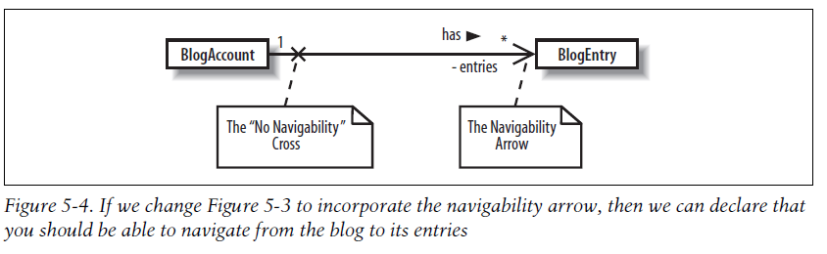
Association with navigability applied to their association relationship

Slide 52
The BlogAccount and BlogEntry classes: Java implementation
public class BlogAccount {
// Attribute introduced thanks to the association with the BlogEntry class
private BlogEntry[] entries ;
// ... Other Attributes and Methods declared here ...
}
public class BlogEntry
{
private BlogAccount blog;
// The blog attribute has been removed as it is not necessary for the
// BlogEntry to know about the BlogAccount that it belongs to.
// ... Other Attributes and Methods declared here ...
}

Slide 53
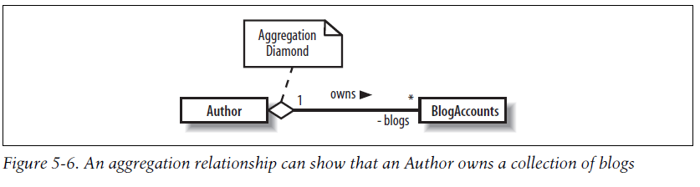
Aggregation
Aggregation is really just a stronger version of association and is used to indicate that a class actually owns but may share objects of another class.
The Java code implementation for an aggregation relationship is exactly the same as the implementation for an association relationship; it results in the introduction of an attribute.
Notes:
Think of other examples

Slide 54
Composition
Composition models the internal parts that make up a class.
Usually be not shared with other parts of the system.
If the “whole” is deleted, then its corresponding parts are also deleted.
Notes:
A blog entry’s introduction and main body sections are actually parts of the blog entry itself and won’t usually be shared with other parts of the system. If the blog entry is deleted, then its corresponding parts are also deleted. This is exactly what composition is all about: you are modeling the internal parts that make up a class.

Slide 55
References
Learning UML 2.0
UML distilled

